Slide 1

SkillSoft Final Presentation
By: Leo H, Aidan L, Lee O, and Gio P
AKA: Team Gamma

Slide 2
Scope
Easily manage projects and deliverables
Keep track of progress every step of the project
Send instant messages to individuals or groups

Slide 3
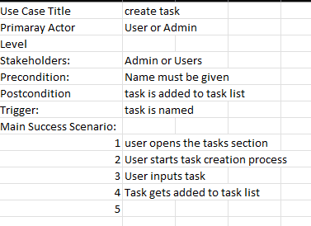
Use Case Scenarios
Shows the task, conditions, triggers and actors
Outlines the process of doing tasks

Slide 4
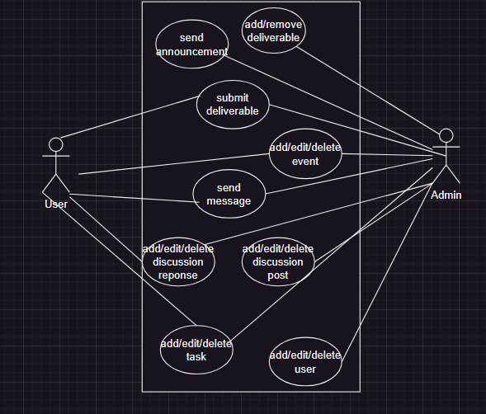
Use Case Diagram
Displays all tasks different users can perform
Ovals represent the actions inside of the system

Slide 5
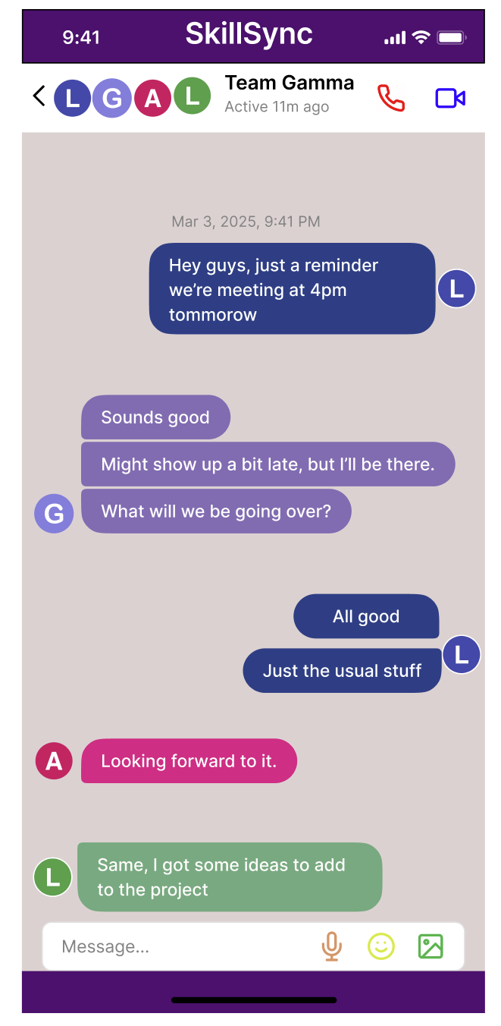
SkillSoft’s Direct Messaging(DMS) and Instant Messaging System (IMS)
Communicate with your peers and professors
Direct messages
Audio calls
Video call
Web Page is responsive
accessible to mobile and PC
Set reminders/deadline
Receive notifications
Weekly, daily, hourly

Slide 6
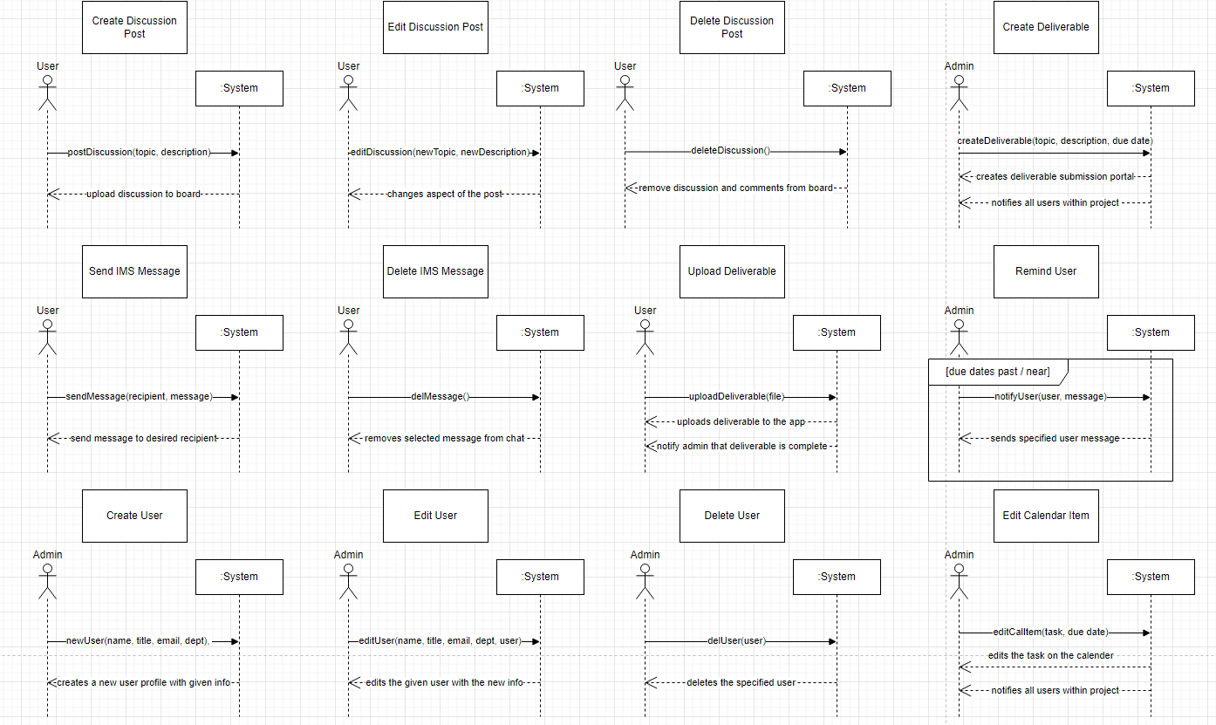
System Sequence Diagram - Aidan
Much more than this…
System messages: received vs sent
CRUD

Slide 7
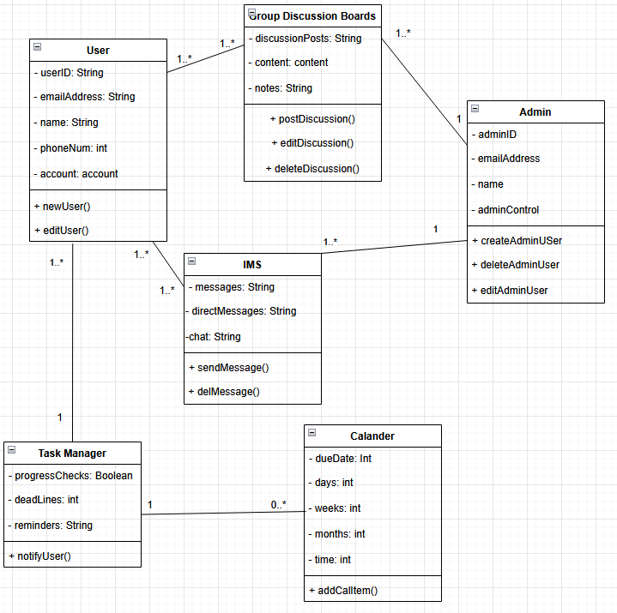
Design Class Diagram
Shows what various variables do and how they are stored
Can help with creating pseudocode. (Ex. Store the userID as a string, newUser() would generate a new userID in an array, etc)

Slide 8
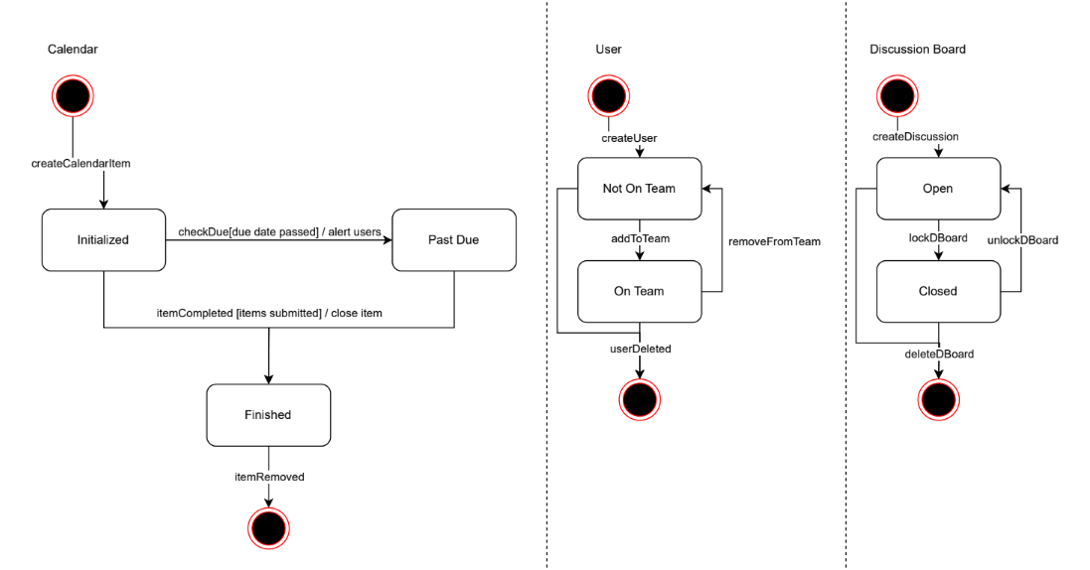
State Chart Diagram - Aidan
State transitions
Helps visualize how parts of the system work

Slide 9
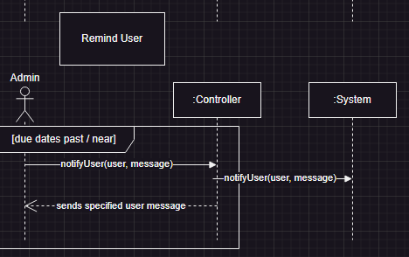
Sequence diagram
Builds on Standard Sequence Diagram
Expands by showing where and what methods go through to get to the system

